Slide 1
Intro To CS
What we did.
Selin Onal

Slide 2
We built robots
*this is not my robot

Slide 3
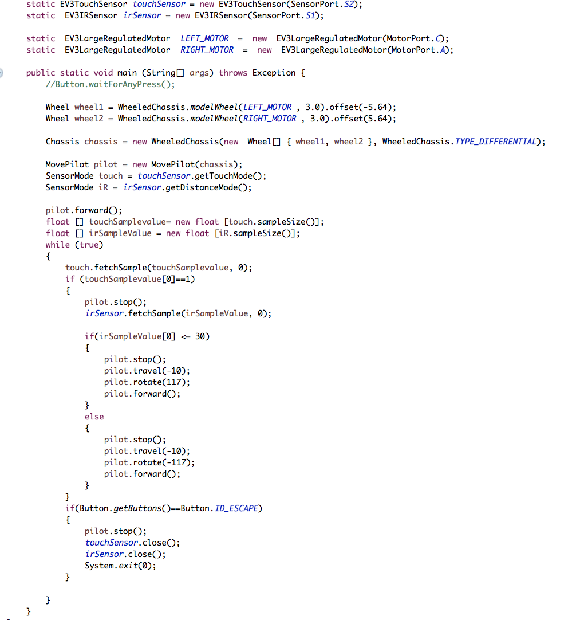
Here comes dat coding
(waddup)

Slide 4
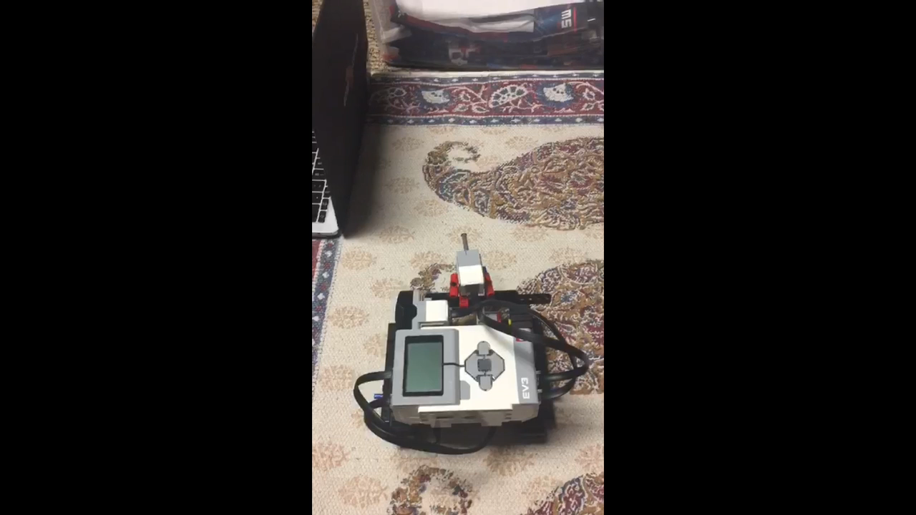
Demonstration? (he’s finding his way)

Slide 5
What I learned
Version Control in Git
Implementing code to solve real-world and real-time problems
Coding as part of a group.
(in boating school is)

